Slide 1

ECE 3030 Physical Foundations of Computer Engineering Physics of Resistors
Asif Khan
Department of Electrical and Computer Engineering
Georgia Institute of Technology
Notes:
Hello and welcome everyone.
It is my great pleasure giving this talk to such a distinguished audience.
My talk is about doing electronics with an advanced class of materials called ferroelectrics and complex oxides.
So let me first tell you what these materials are and why we want to use them.

Slide 2
Reference
Modern Semiconductor Devices for Integrated Circuits
Chapter 2: Section 2.2.1

Slide 3
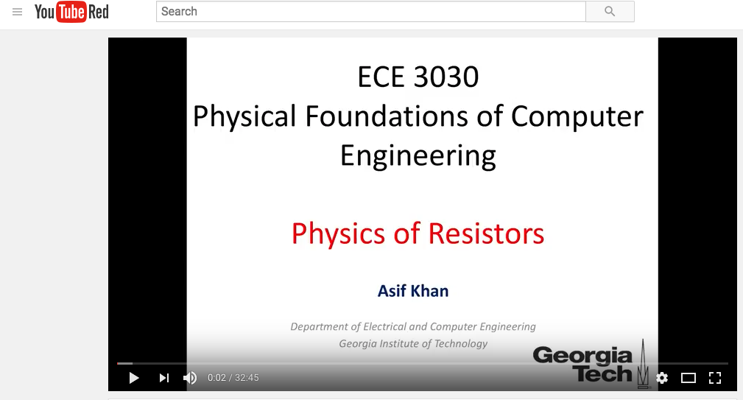
Resources
Recorded lecture available at: https://www.youtube.com/watch?v=iNekoq3Jedc

Slide 4
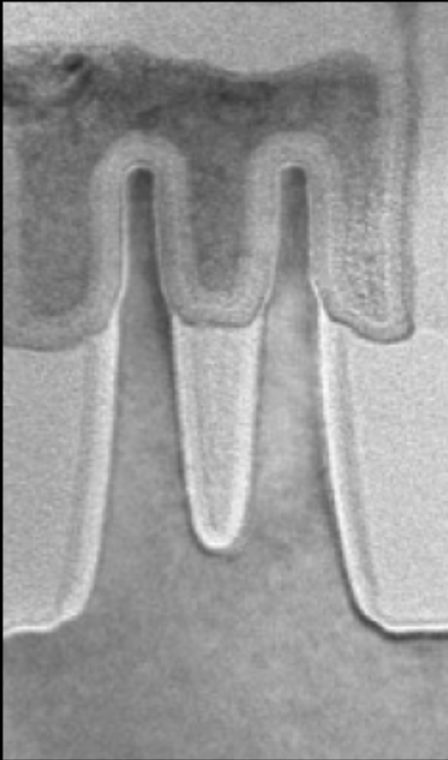
Physics of resistors (metals/interconnects/contacts)
Intel Broadwell 14 nm node, 2014
MOSFET
Metal
Oxide
Semiconductor
http://electroiq.com/chipworks_real_chips_blog/2014/
http://www.extremetech.com/computing/193200-intels-14nm-broadwell-chip-reverse-engineered-reveals-impressive-finfets-13-layer-design

Slide 5
Circuit Elements for Integrated Circuits
Linear Circuit Elements
Non-linear Circuit Elements
Resistor, R
pn Junction
Diode
Capacitor, C
n-type
p-type
MOSFET
(Metal-Oxide-Semiconductor
Field Effect Transistor)
Inductor, L
Basis for Digital Computing

Slide 6
Circuit Elements for Integrated Circuits
Materials
Metal
Dielectric/Oxide
Semiconductor
R
n-type
p-type
L
Rectifier/
Diode
C
n-type
p-type
MOSFET

Slide 7
Physics of resistors (metals/interconnects/contacts)
b
R
A=ab
dQ
V=IR
a
v
L
I
E=electric field=V/L
j=current density=I/A
V
+
-
j=σE
j=σE
v=(σ/nq)E
v=μE
μ=mobility of an electron
σ=conductivity=L/(AR)
ρ=1/σ=resistivity=RA/L
F=force on an electron=qE
Velocity of an electron is proportional to the electric field (or the effective force)!
R=ρL/A

Slide 8
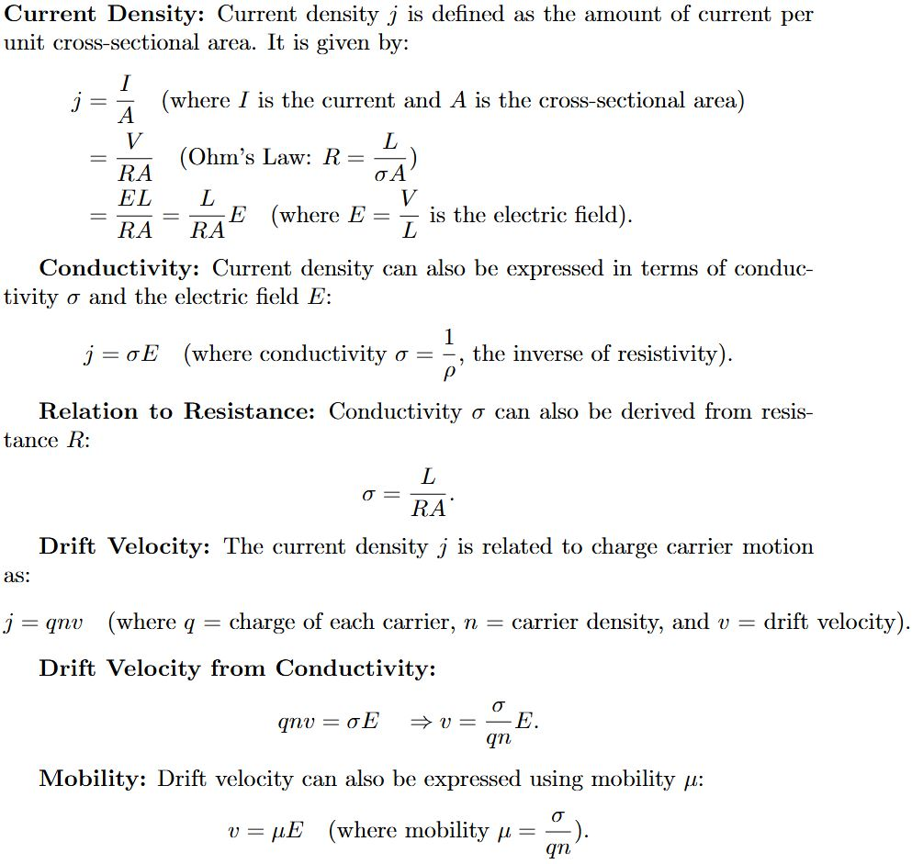
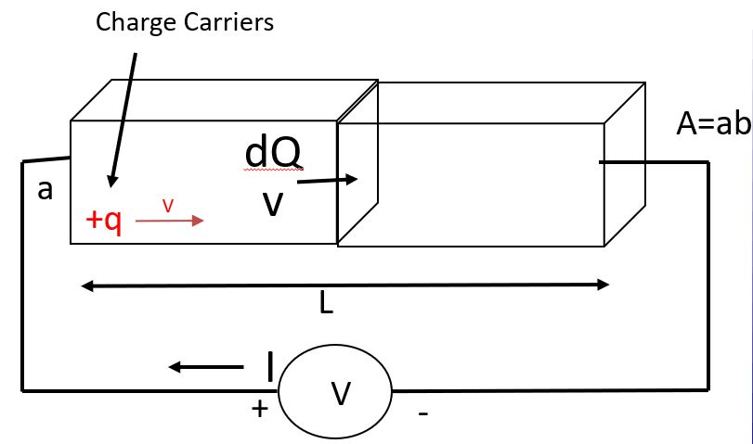

Slide 9
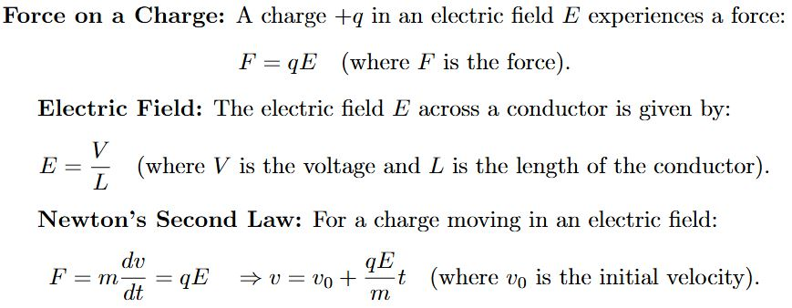

Slide 10
Physics of resistors (metals/interconnects/contacts)
Newton’s law of motion suggests that charge carrier should be accelerating!
Why does the velocity of an charge carrier remain constant although there is a force on an electron?

Slide 11
Physics of resistors (metals/interconnects/contacts)
Your skydiving experience may tell something!

Slide 12
Electron gas model
Without an electric field
With an electric field
E

Slide 13
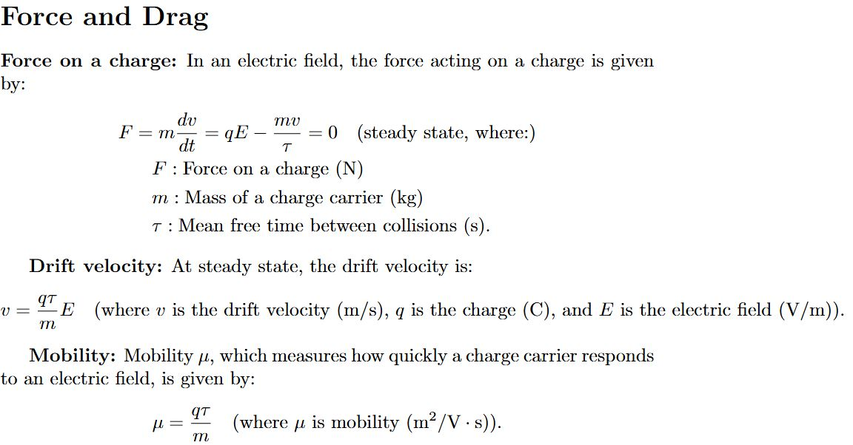

Slide 14
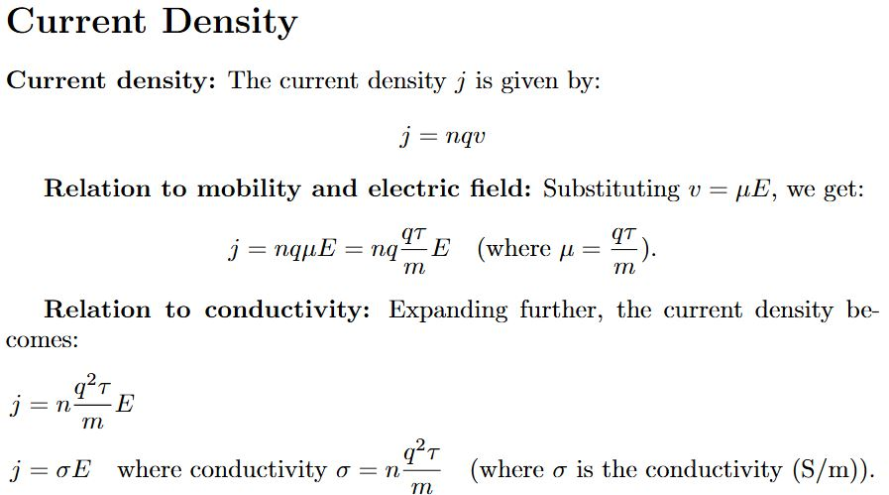
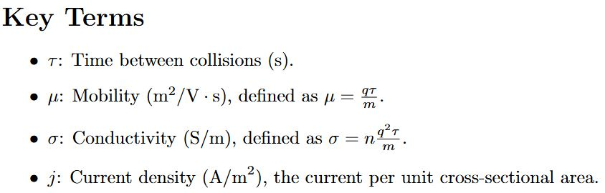
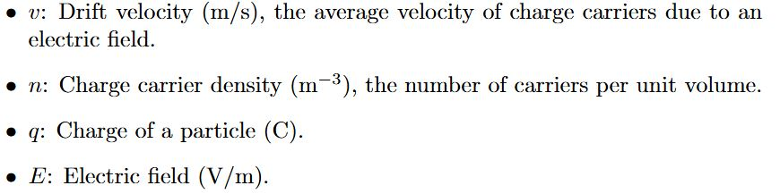

Slide 15
Physics of resistors (metals/interconnects/contacts)
Typical crystal structure of a metal
a=~0.5 nm
Atomic density=4/a3=~3e28 m⁻³
Electron configuration
Al (13): [Ne(10)] 3s²3p¹
Cu(29): [Ar(18)] 3d¹⁰4s¹

Slide 16
Physics of resistors (metals/interconnects/contacts)
Al or Cu for interconnects?
Metal | μ (m²/Vs) | n (m³)
Al | 1.2x10⁻³ | 1.98x10²⁹
Cu | 4.32x10⁻³ | 8.5x10²⁸

Slide 17
Physics of resistors (metals/interconnects/contacts)
Al or Cu for interconnects?
Metal | μ (m²/Vs) | n (m³) | ρ (Ω-m)
Al | 1.2x10⁻³ | 1.98x10²⁹
Cu | 4.32x10⁻³ | 8.5x10²⁸

Slide 18
Physics of resistors (metals/interconnects/contacts)
Al or Cu for interconnects?
Metal | μ (m²/Vs) | n (m³) | ρ (Ω-m)
Al | 1.2x10⁻³ | 1.98x10²⁹ | 2.63x10⁻⁸
Cu | 4.32x10⁻³ | 8.5x10²⁸ | 1.7x10⁻⁸
Cu

Slide 19
Physics of resistors (metals/interconnects/contacts)
Material | ρ (x10⁻³ Ω-m)
W | 8-15
Al | 2.7-3.0
Cu | 1.7-2.0
With scaling, why are moving away from Al towards Cu?

Slide 20
Physics of resistors (metals/interconnects/contacts)
Material | ρ (x10⁻³ Ω-m)
W | 8-15
Al | 2.7-3.0
Cu | 1.7-2.0
With scaling, why are moving away from Al towards Cu?
(think about the four metrics)

Slide 21
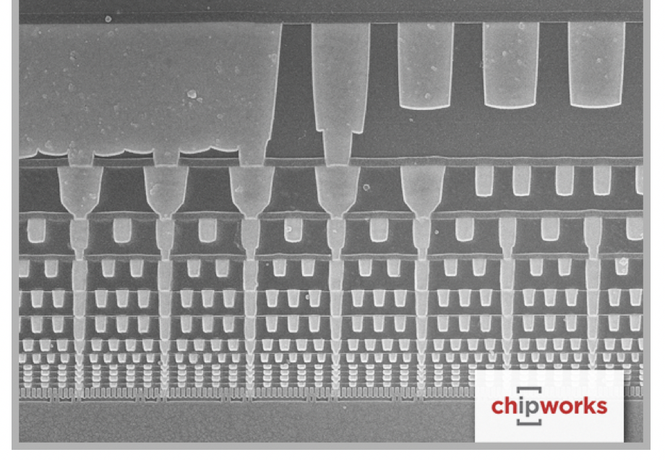
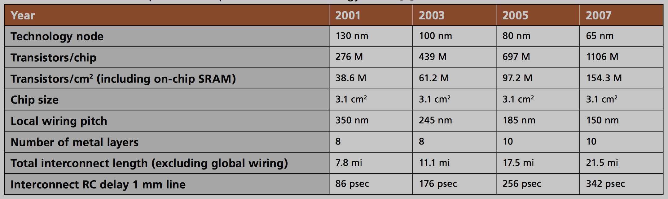
Physics of resistors (metals/interconnects/contacts)
There are more than 10 miles of wires in a microprocessor!
http://www.advanced-energy.com/upload/file/white_papers/sl-electroplating-270-01.pdf

